Slide 1
Computer vision application
Pet detection using tensorflow api
By
Neraj Oblakumarbabu & Manisha pulluru

Slide 2
Setting up the Detection api
Based on Object Detection Tutorial from Github/tensorflow/research
Used open CV2 module to integrate the model with webcam
COCO model was initially tested.
This API allowed us to run and test various models.

Slide 3
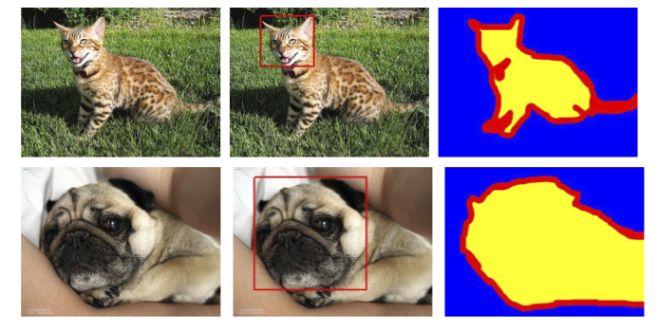
Dataset
Oxford IIIT Pets Dataset has been used.
Annotations for each image.
37 classes of pets
25 breeds of dogs and 12 breeds of cats.
Approximately 200 images for each class.
Each image has the following:
Image information
A box around the head of the pet.
A foreground-background segmentation at the pixel level

Slide 4
model
SSD MobileNet V2 has been used.
Transfer learning has been implemented to speed up the process.

Slide 5
Training and evaluation
Evaluation methods used:
Shape Only – Uses only the face of the pet with boxing.
Appearance Only – Uses the position of the body to detect the pet.
Shape and Appearance Only – Uses both the Shape and Appearance to accurately Classify.

Slide 6
accuracy
Method | Accuracy | Result
Shape only | 91.21 | Puppies identified as cats due to similar face shapes
Appearance only | 91.88 | Furry English Setter was identified as English Cocker Spaniel due to similar appearances
Shape and Appearance only | 94.89 | Problems were overcome and pets were classified correctly

Slide 7
Challenges
Attempt to add a new class of pet breed to the dataset.
40 images of “Dobermann” breed were collected and fed into dataset for training.
Technical issues + Misclassification
Annotation were important and missing in new images.
Face boxes and foreground-background segmentation was missing.
CONTRIBUTION - Addition of Multi-threading in the API.
Difference in latency of 50ms.

Slide 8
applications
Hey Google, Where's my pet? Integration of Google Assistant and home camera system to locate pets.
Marketing on social media: Social media could use this API to detect pets from live feed and promote relevant pet products.

Slide 9


Q/A

